Slide 1
Diving deeper into density

Slide 2
Density by the book:
Get a book from the back table for your group
Copy the definition
Return the books
GO!

Slide 3
Density by the book:
What did you learn?
  The amount of mass of a substance in a given volume; the mass per unit volume.
HUH?? Here’s what I heard…
  Blah blahblah blah blah blah blah blahblah blah blah blahblah blah blah; blah blah blah blah blahblah

Slide 4
So, what does that mean?
Talk to your group and “translate” this definition into 7th grade words.
Think about this:
  You already know every word in the book definition
  When you put those words together, they made no sense!
  How can you make the definition make sense to YOU?

Slide 5
Break it down!
The amount =
of mass =
of a substance =
in a given volume =
how much
matter (stuff)
something
is in a certain space

Slide 6
Let’s talk math!
A formula is a “math sentence”.
How do you find the volume of a rectangular prism?
  What do you say?
    Volume is length times width times height.
  How do you write it mathematically?
    Talk with your groups and be ready to report out
    V = l X w X h

Slide 7
IF….
Density is mass per unit volume, what is the FORMULA?
Talk with your groups and be ready to report out:
  D = m/v
  D = m ÷ v
  D =

Slide 8
Principles of Density
What the Principle Says | What the Principle Means | How I know the Principle is True
(the BLAH, BLAH words)
(translate to your 7th grade words)
(give an example of proof!)
If you add more mass to the same volume, it is more dense!
If you add the same mass to less volume, it is more dense!
Just because something has more mass, doesn’t mean it’s more dense!

Slide 9
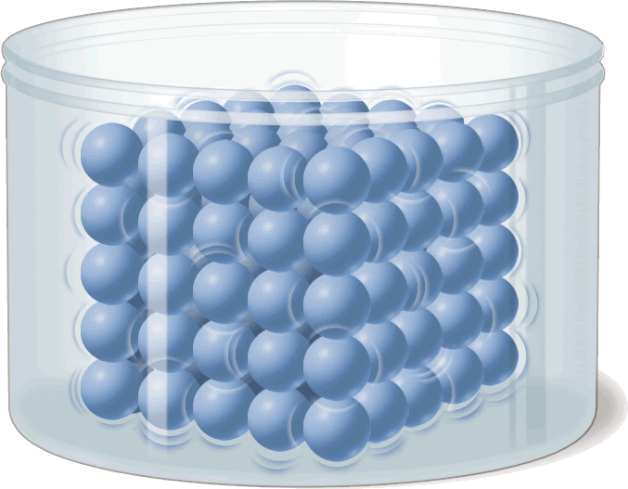
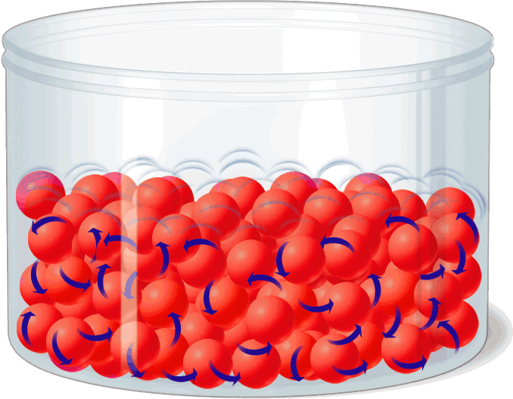
Density
  More dense = more particles
  Less dense = less particles

Slide 10
Comparing liquids
Do liquids have different densities???
Of course. . . So what happens when you mix them together???
Talk with your groups and create a hypothesis about what will happen when liquids of different densities are placed into the same cylinder.
They form layers with the highest density falling to the bottom.
Alcohol = .79 g/ml
Vegetable Oil = .92 g/ml
Water = 1.0 g/ml
Maple Syrup= 1.37 g/ml

Slide 11
Consider this: the Density of pure water = 1.0 g/ml
If an object has a density greater the 1.0 g/ml, then it will sink in water.
If an object has a density less than 1.0 g/ml, then it will float in water.
So. . . This means that knowing the density of an object lets you know
if it will sink or float in water.
But. . . What if the density was exactly 1.0 g/ml?
THEN…the object will be suspended in the liquid!

Slide 12
Try Your own
Sea Water = 1.03 g/ml
Gasoline = 0.7 g/ml
Turpentine = 0.9 g/ml
Glycerine = 1.3 g/ml
Pure Water = 1.0 g/ml

Slide 13
Comparing densities
What can you tell me about Coke vs Diet Coke?
  Density comparison?
  Sink or float?
What can you tell me about fresh water vs salt water?
  Density comparison?
  What would happen if they combined?

Slide 14
Does the sample size affect the density of an object???
In other words, if you break a piece off of an object. . .
Will it have a different density than the whole piece?
NOOOOOOO!!! Density is based on total mass divided
by total volume. When one changes,
the other also changes, so the density stays the same!!!

